Slide 1

Institute of Aeronautical Engineering
(Autonomous)
Department of Electronics and Communication Engineering
DESIGNING A PORTABLE OXIMETER USING
ARDUINO MICROCONTROLLER & MAX30102
Supervisior:
Dr. V Padmanabha Reddy
Professor of ECE
Dr. D Srikar
Assistant Professor of ECE
STUDENT
19951A04K7 – Vaishnavi S

Slide 2
Abstract
The design, implementation, and testing of a pulse oxygen saturation detection device employing an Arduino microcontroller with an integrated circuit sensor as the major portion of the system are discussed in this research report.
The optical sort sensor faculties the blood vessel oxygen immersion status from the circulatory system of the fingertips of a patient and changes it into the proper computerized organization to be perused by the microcontroller's ports as per its guidance sets.
Pulse rate and blood oxygen immersion state (SpO₂) from peripheral capillary are the physiological boundaries that are checked. Arduino Uno microcontroller is the heart of this system, processing electrical impulses and converting them to the required SpO₂ value.

Slide 3
Introduction
In 2019, Wuhan, China, was impacted by the continuous novel (COVID-19) pandemic. The COVID-19 pandemic was spread practically all over the world by the beginning of 2020. It was labelled a pandemic by the World Health Organization (WHO).
In closed cases, the current death rate owing to coronavirus infection is roughly 2.2 percent. Regardless, the loss rate can be reduced if a COVID-19 patient's oxygen submersion and pulse rate is evaluated properly and consistently.
This would lower the probability of treatment failure, resulting in fewer uncommon fatalities and advantages for frontline medical personnel.

Slide 4
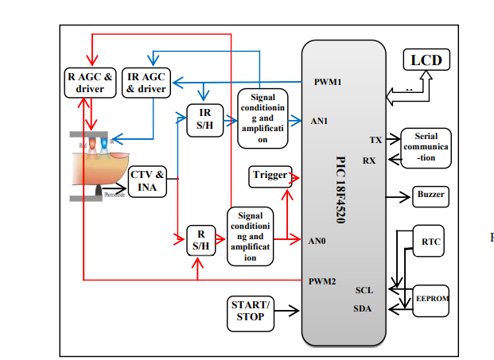
Existing Method Block Diagram

Slide 5
Problem Defined
Portability In the existing method the device is not portable as the photodiode and other LEDs are exposed.
Major drawback They have only measured the oxygen saturation levels
Accuracy Because different lights are taken separately the accuracy of the system decreases.

Slide 6
Objective
The main objective of this project is to design SpO2 & heart rate measurement device
To make it portable and increase the accuracy

Slide 7
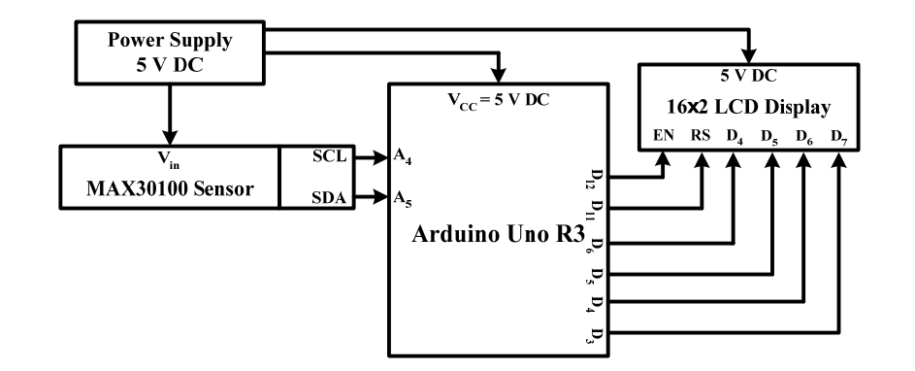
Proposed Block Diagram
OLED
MAX30102

Slide 8
Software Used
Arduino IDE

Slide 9
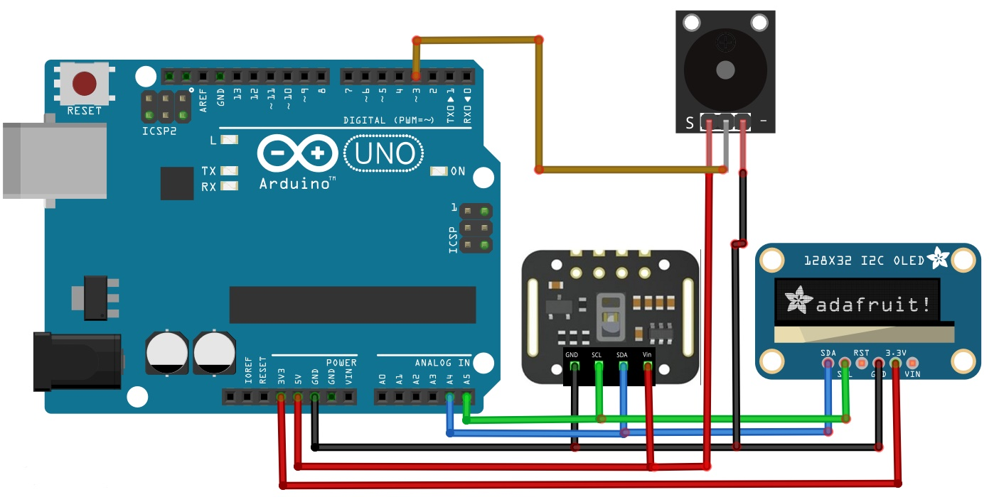
Circuit Diagram

Slide 10
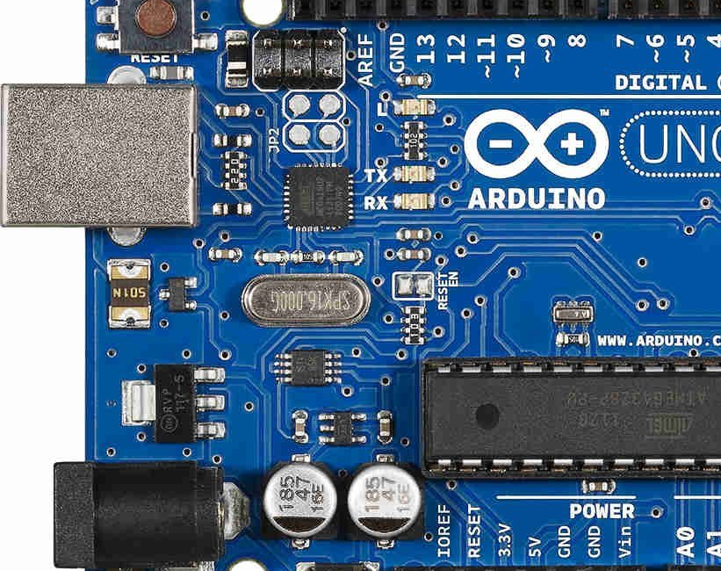
Arduino microcontroller
Arduino Uno microcontroller is utilized here to have low power utilization, higher effectiveness, in-assembled ADC office, and USART mode correspondence ability.
In-constructed ADC can change over the Pulse Amplitude Modulated sign into a computerized design. The serial data transmission can be facilitated by using the USART mode communication to send and receive pulse oximetry data into and out of the microcontroller.

Slide 11
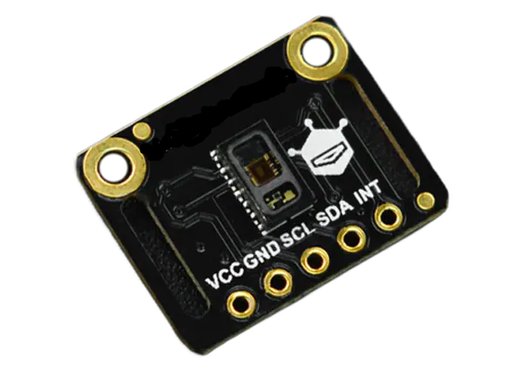
MAX30102 SENSOR
MAX30102 sensor is used to detect blood oxygen and heart rate. Here, infrared radiation is sent and reflected by hitting the finger, and then the amount of oxygen in the blood is determined by measuring the wave amplitude. Heart rate is also obtained by analyzing the time series response of this radiation.

Slide 12
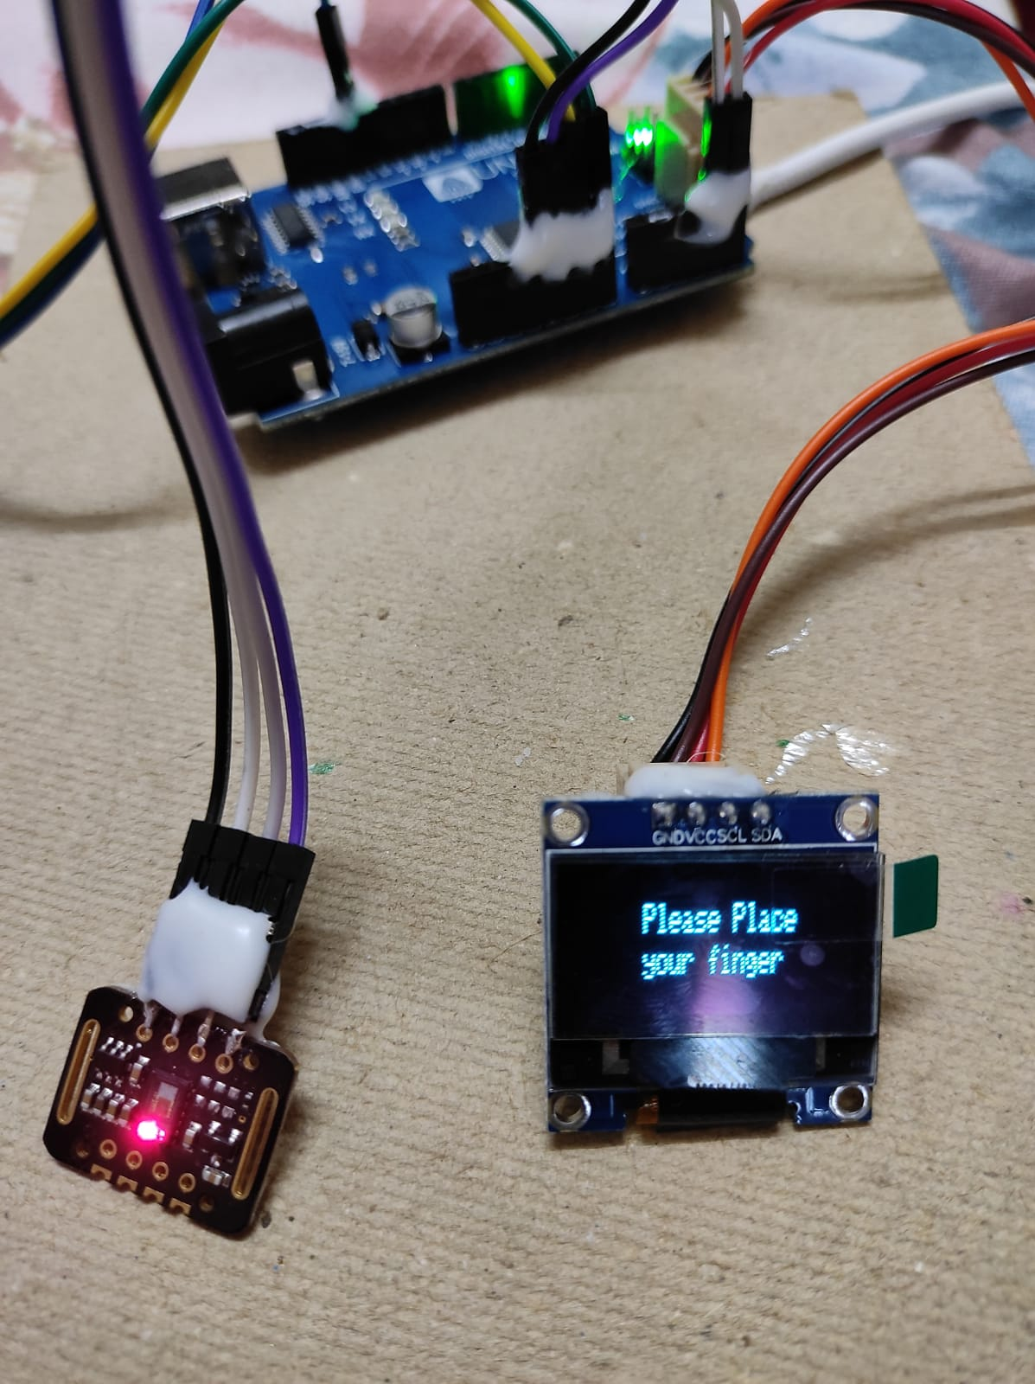
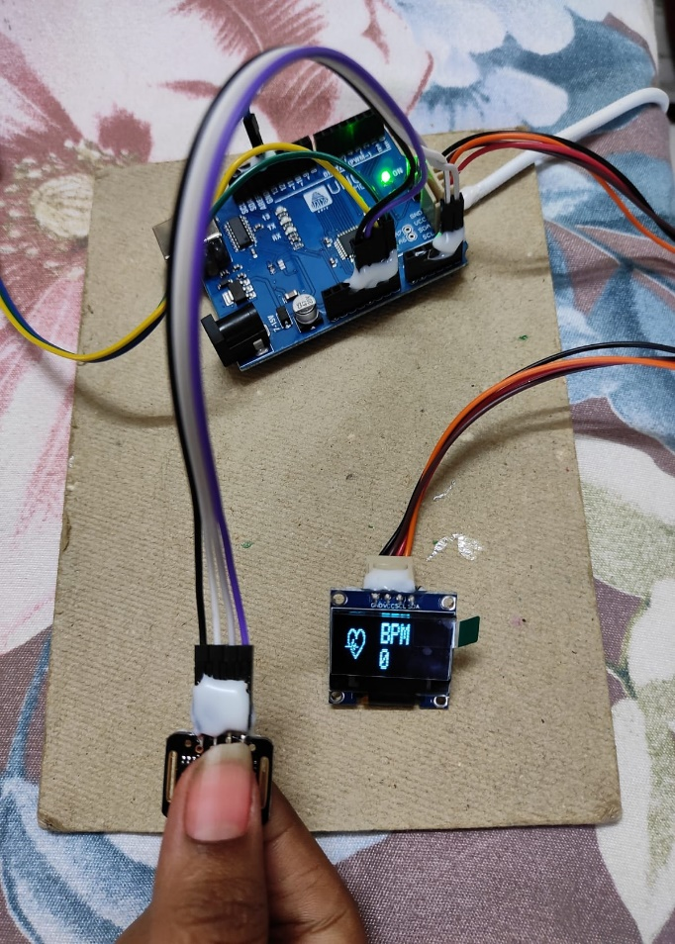
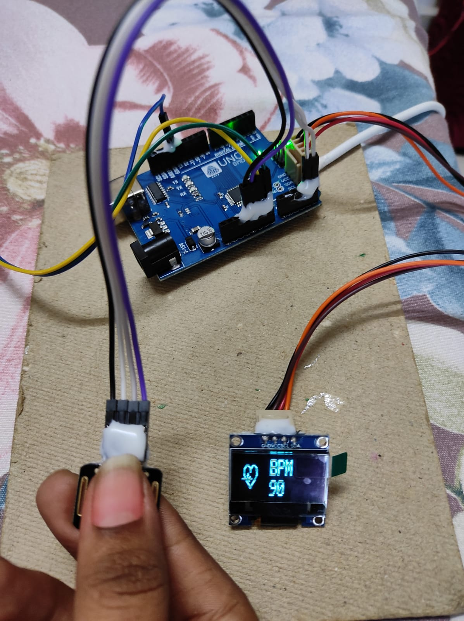
The final version of prototype/product:

Slide 13
Results
We have designed, simulated, implemented, and tested a simple and low-cost pulse oxygen saturation level measuring device using a microcontroller and a sensor. The system is portable and no medical personnel is required to measure the oxygen level of a patient. The patient can easily measure and monitor his oxygen level and send the data for taking advice or treatment from any remote places without going to the doctors or physicians.

Slide 14
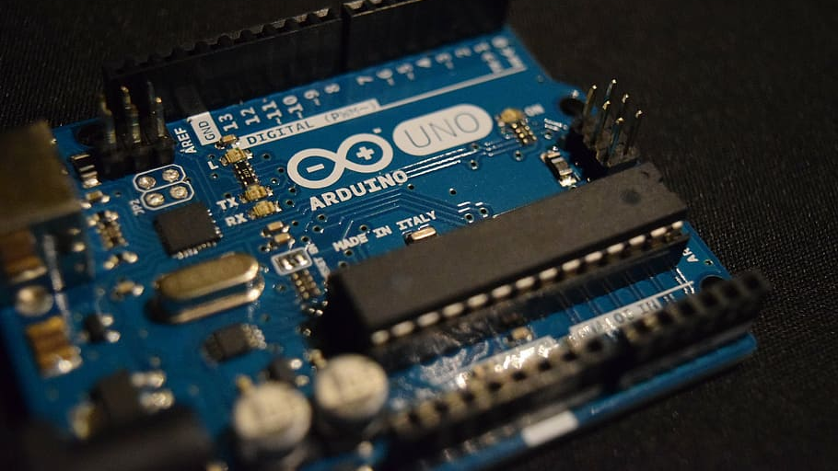
Thank you

